Slide 1

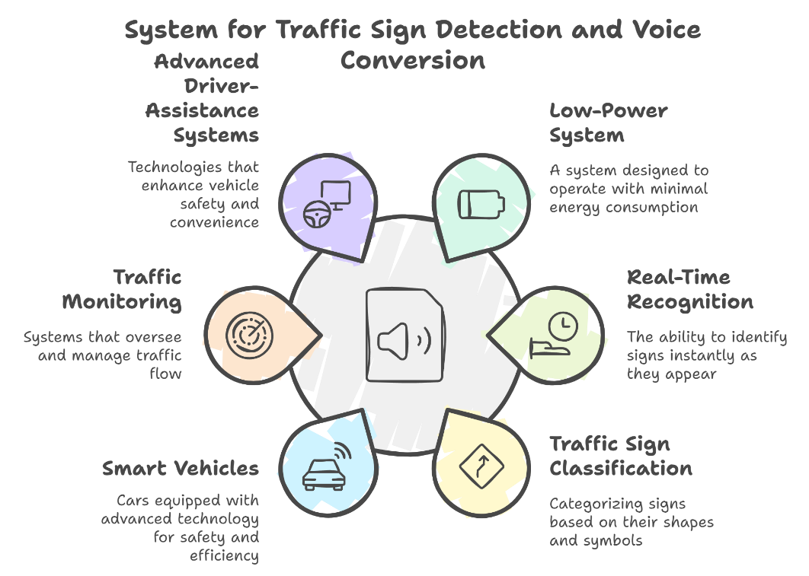
Traffic Rules Auto Assistance
Batch No:01 Roll Nos:40,32,52,54 SRNs: 02FE22BEC032, 02FE22BEC040 , 02FE22BEC054 , 02FE22BEC056
Student Names:Nandeesh,Priyanshu,Priyanka,Jamuna Guide: Prof . Shridhar Iyer
Context: Traffic sign detection involves creating a low-power, real-time system that recognizes and classifies traffic signs with minimal computational resources. This technology has applications in smart vehicles, traffic monitoring, and advanced driver-assistance systems (ADAS), with potential for future enhancements like real-time alerts .
Problem statement : We aim to design a smart system that can detect and interpret road signs in real-time and convert detected text into voice alerts using a compact machine learning model. This system is optimized for portable devices, allowing it to operate independently on small, low-power hardware without requiring extensive computational resources.
Deliverables :
Real-time road sign detection adaptable to large-scale road networks.
Reduce false positives and improve classification accuracy for traffic signs.
Improve accuracy for distant signs and complex backgrounds in autonomous driving.
Provide accurate multi-class sign detection with reduced false positives.
Training / Pre-Requisites :
Understanding traffic rules and how to translate them into actionable algorithms.
Understanding image processing and object detection principles
Understanding of basic ML concepts, including supervised learning, model training, and evaluation metrics.
Drivable
Timeline
Kick Off < 1st Month >
Milestone 1 < 2nd Month >
Milestone 2 < 3rd & 4th Month
Starter Reference Material
https://youtu.be/UaNy53AnAQg?si=Imcemhx2Auy99uCj
https://youtu.be/bZIKVaD3dRk?si=LtaGxKY-ECPDdJ5Y
Initiating project with team discussion
Explore YOLO V5 ML technology and its applications.
Identify articles and online resources that will assist in understanding the project scope.
Literature Survey.
Identifying the base paper
Training and Initial Testing
Selection of dataset
Conduct tests to evaluate its accuracy on sign detection.
Documentation and applying for contests

